Slide 1
TEXT RECOGNITION USING NEURAL NETWORK
Group Members:
Abheek Gulati
Glen D’sa
Aditya D’Monte
Anish D’souza
Project Guide:
Mrs. Neeta Patil

Slide 2
Introduction
Problem Statement:
Today’s text recognition engines use multiple algorithms to recognize fonts, but due to irregularities in text and font more intelligent approaches are essential.
Also due to the massive increase in available data sets and their inherent inconsistencies, recognition systems need robust training to be accurate.
Data obtained from multiple sources lacks uniformity and consistency.
An autonomous tool that can extract textual data and present it in a uniform way aiding data analysis is the need of the hour.

Slide 3
Introduction
Scope:
Neural Network must be trained using a large training set to maximize its accuracy.
The end system should be completely autonomous.
Primarily, the system should greatly aid in the extraction of textual data from large, unorganized data sets.

Slide 4
Literature Survey: Existing Systems
Existing Systems:
SAS text Miner: SAS Text Miner discovers themes, patterns, emerging issues and insights buried in document collections.
IBM LanguageWare : The IBM suite for text analytics (tools and Runtime) LanguageWare is a natural language processing (NLP) technology developed by IBM, which allows applications to process natural language text.
RapidMiner: With its Text Processing Extension – data and text mining software: RapidMiner, formerly YALE (Yet Another Learning Environment), is an environment for machine learning, data mining, text mining, predictive analytics, and business analytics. It is used for research, education, training, rapid prototyping, application development, and industrial applications

Slide 5
Literature Survey
Existing Systems:
Google Brain: Google Brain is an unofficial name for a deep learning research project at Google.
A breakthrough in machine learning came by way of Google Brain, which consisted of 1,000 servers (16,000 CPU cores) simulating a model of the brain with a billion synapses (connections). Google Brain was trained using ten million 200x200 images unsupervised in three days. At the end, Google Brain revealed that there are two types of images that show up on the Internet quite frequently: faces and cats.

Slide 6
Literature Survey
Existing Systems:
Nvidia’s GPU-centric approach: In response to Google Brain, Nvidia said that a billion synapses is what you'll find in a honey bee. To emulate an actual human brain, you'll need a 100 billion neurons with a thousand connections each, equaling around 100 trillion connections. To train this brain using Google Brain's setup, you'll need a lot more images -- around 500 million images – and lots of time: about 5 million times longer than that of the honeybee brain setup.
Naturally Nvidia tackled this problem by developing a solution of its own. Huang said that it's now possible using three GPU-accelerated servers: 12 GPUs in total, 18,432 CUDA processor cores (Google Brain has around 16,000 cores). The Nvidia solution uses 100 times less energy, and a 100 times less cost.

Slide 7
Literature Survey
The autonomous extraction of previously unstructured and haphazard textual information from a document and its subsequent re-organization and presentation in order to assist a data analyst in the tasks of visualizing and that of deriving meaningful inferences from the contained data.
As most information (common estimates say over 80%) is currently stored as text, extraction, or mining of textual data is believed to have a high commercial potential value.
The use of neural networks for a task such as this appears appropriate, as different files and data sets will often, if not always, contain discrepancies in font and even script. Therefore, rigid approaches involving traditional algorithmic methods that lack flexibility in their operations are not apt for this task. At the same time, a fully artificial intelligent system isn’t the only solution.

Slide 8
Literature Survey
Merits of Proposed System:
Automates the tedious, time consuming and error-prone task of extracting textual data from data sets of varying sizes and characteristics.
System can be trained to recognize a wide variety of fonts and distinguish text from images, graphics and other such elements.
Aids the data analyst in interpreting and visualization data patterns.

Slide 9
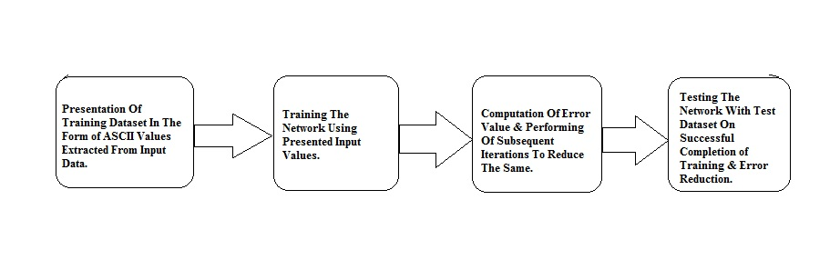
Design: Block Diagram
fig) Block Diagram

Slide 10
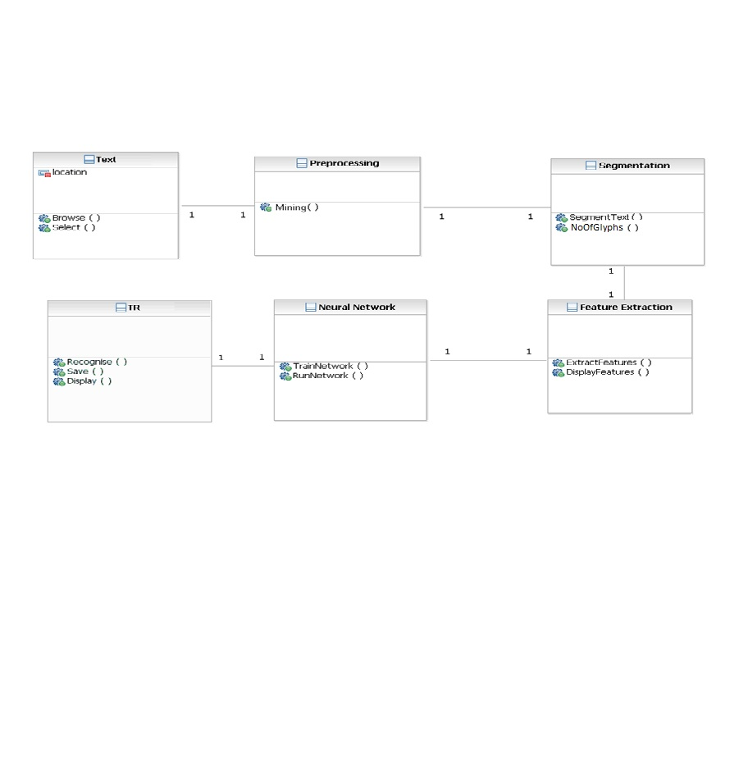
CLASS DIAGRAM

Slide 11
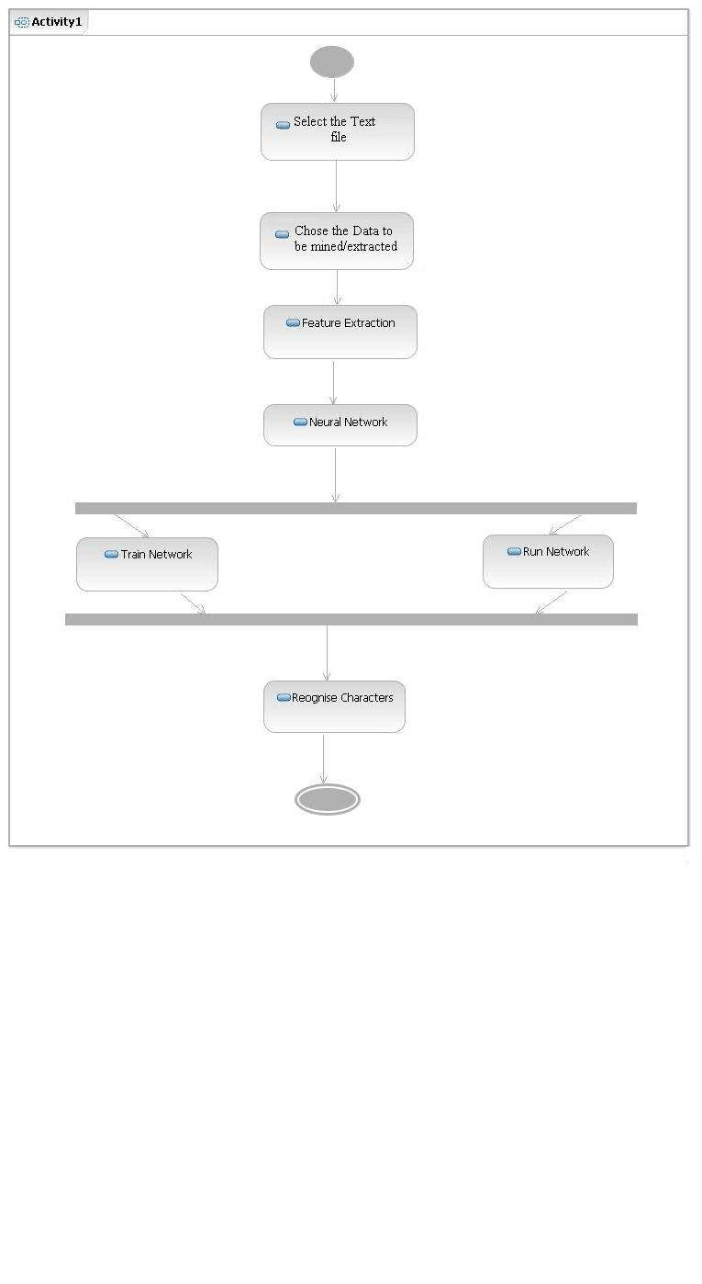
ACTIVITY DIAGRAM

Slide 12
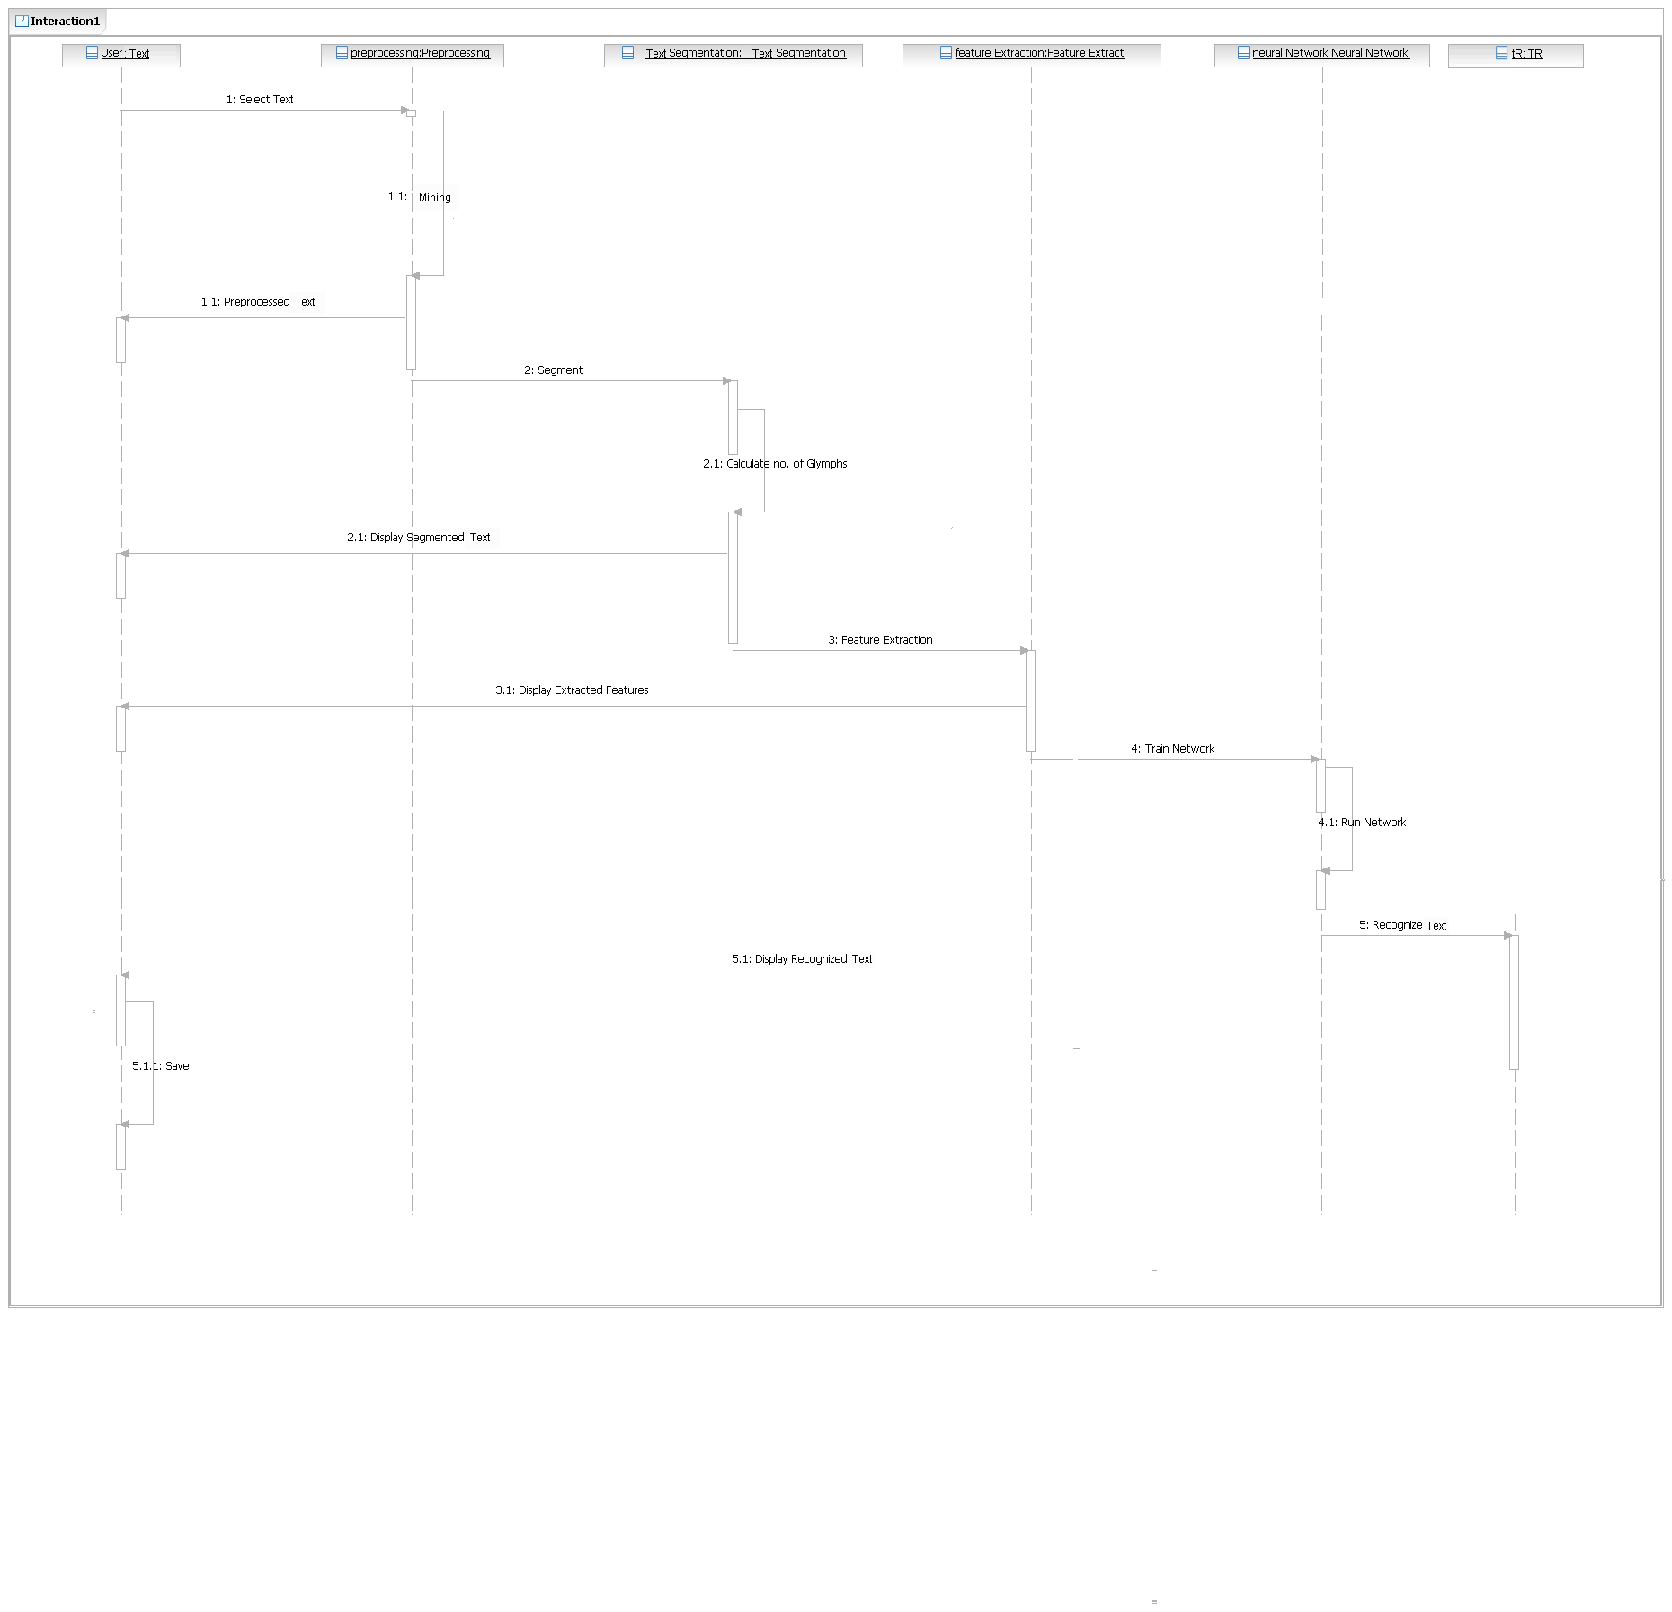
SEQUENCE DIAGRAM

Slide 13
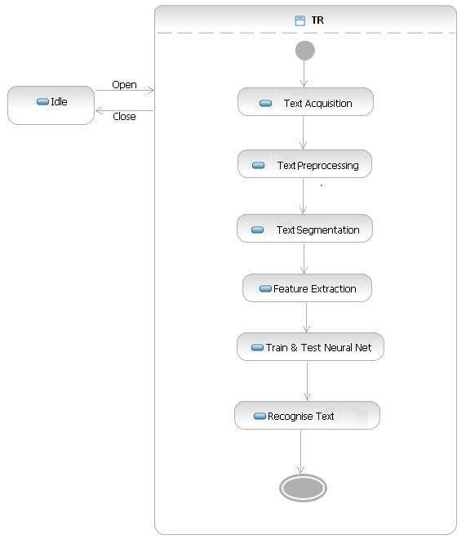
STATE DIAGRAM

Slide 14
Implementation
Breaking Down The Math: Forward Pass
Computation of A Neurons Input: n X w
where n: previous neurons output
w: weight of connection to current neuron
Computation of A Neurons Output: 1/(1+exp(Neurons input))
Computation of Error: e = T – d
where T: target
d: actual obtained output

Slide 15
Implementation
Breaking Down The Math: Backward Pass
Change In Weights Of Connections to Output Layer:
Old Weight + ( learning rate*output error*output of previous layer*output of current layer*(1-output of current layer))
Change In Weights Of Connections to Intermediate(Hidden) Layers:
Old Weight + ( learning rate*output error*output of previous layer*output of current layer*(1-output of current layer)*output of neuron in next layer*(1-output of neuron in next layer)*weight of connection from current to next neuron)
Computation of net Error:
Square Root(Squared Sum of Error After Each Iteration)

Slide 16
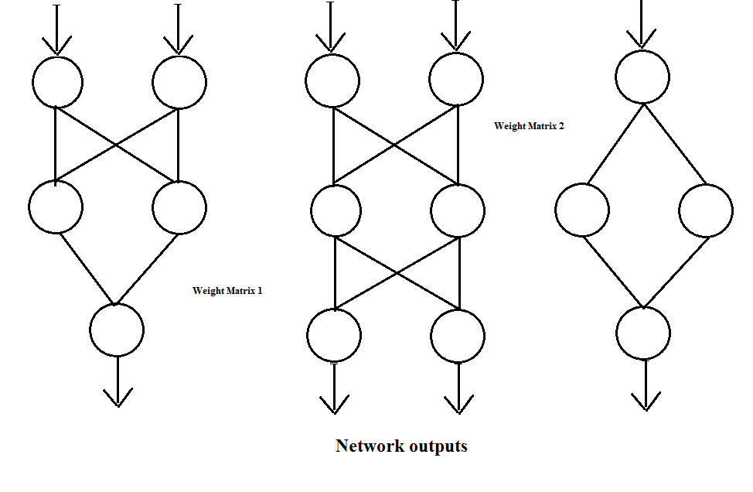
Implementation

Slide 17
Implementation
Backpropagation Algorithm:
Backpropagation, an abbreviation for "backward propagation of errors", is a common method of training artificial neural networks. From a desired output, the network learns from many inputs, similar to the way a child learns to identify a dog from examples of dogs.
It is a supervised learning method.
It requires a dataset of the desired output for many inputs, making up the training set. It is most useful for feed-forward networks (networks that have no feedback, or simply, that have no connections that loop).

Slide 18
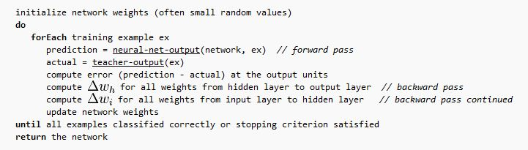
Implementation: Algorithm

Slide 19
Implementation
Algorithm for a 3-layer network (only one hidden layer):
Initialize Network Weights(Random Small Values)
Present Training Data.
for(Specific Number of iterations)
{
for(Number of Training Examples)
{ //Forward Computation
Compute Network Output Using Current Network Weights.
Compute Error
//Backward Computation
Propagate Weight Changes From Final To Initial Layers
}
Compute Net Error
}
Test Network Using Test Dataset

Slide 20
References
[1] Catalin I.Tomai, Bin Zhang and Sargur N.Srihari, “Discriminatory Power of Handwritten Words for Writer Recognition,” Proceedings of the 17th International Conference on Pattern Recognition (ICPR’04).
[2] Marius Bulacu, and Lambert Schomaker, “Text-Independent Writer Identification and Verification Using Textural and Allographic Features,” IEEE Trans. Pattern Analysis and Machine Intelligence, vol. 29, no.4, April 2007.
[3] R.Plamondon and S.N.Srihari. “Online and Offline Handwriting Recognition: A Comprehensive Survey,” IEEE Trans. Pattern Analysis and Machine Intelligence, vol. 29, no.1, Jan. 2000.

Slide 21
Conclusion And Future Work
We draw the conclusion that neural networks are a viable option for the recognition and extraction of unstructured textual data due to their learning capabilities & lack of rigidness.
A System can be built that successfully recognizes characters and thus fits into a larger sophisticated text mining & character recognition platform.

Slide 22
THANK YOU

